Slide 1
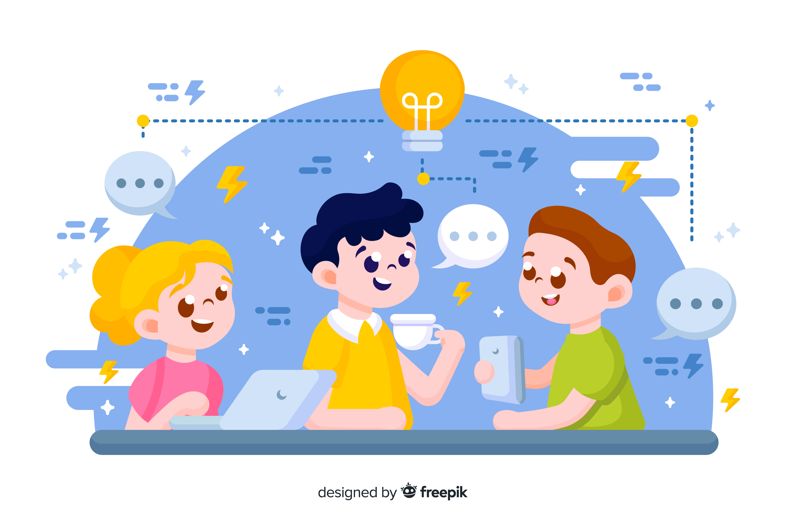
Learn Programming For Kids (Python)

Slide 2
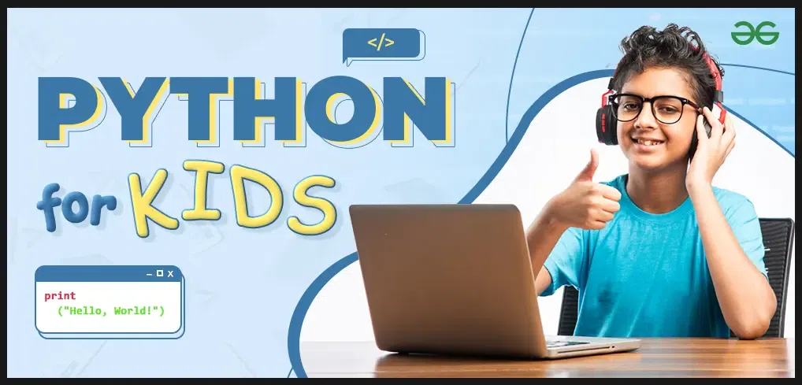
Python is an easy-to-understand and good-to-start programming language.

Slide 3
Table of Content:
1. What is Python?
2. Why Python for Kids?
3. Getting Started with Python
3.1. Installing Python
3.2. Python IDE
4. Python Syntax
5. First Python Program – Hello, World!
6. Python Variables

Slide 4
7. Python Inputs
8. Python Datatypes
8.1 Int
8.2 Float
8.3 String
8.4 Boolean
8.5 List
8.6 Tuple
8.7 Dict
8.8 Set

Slide 5
9. Python Operators
10. Control Flow
10.1. Conditional Statements
10.2. Loops
11. Functions and Modules in Python
11.1 Python Functions
11.2 Python Modules
12. OOPS in Python
13. Fun Activities – Python Projects for Kids

Slide 6
Lesson 2
Hello, Python!

Slide 7
1. What is Python?
Imagine Python is like a magical spellbook for your computer. In this spellbook, instead of casting spells, you write down special instructions in a language that the computer understands. This magical language is called "Python."
So, when you want your computer to do something fun or interesting, like draw a picture or play a game, you open your Python spellbook and write down the steps. Python helps you talk to your computer in a way that's clear and easy, making it a great language for beginners who are just starting their journey into the world of coding magic!

Slide 8

2. Why Python for Kids?

Slide 9
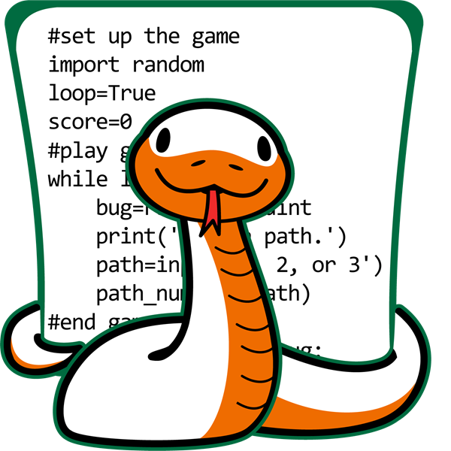
Easy to Read and Understand

Slide 10
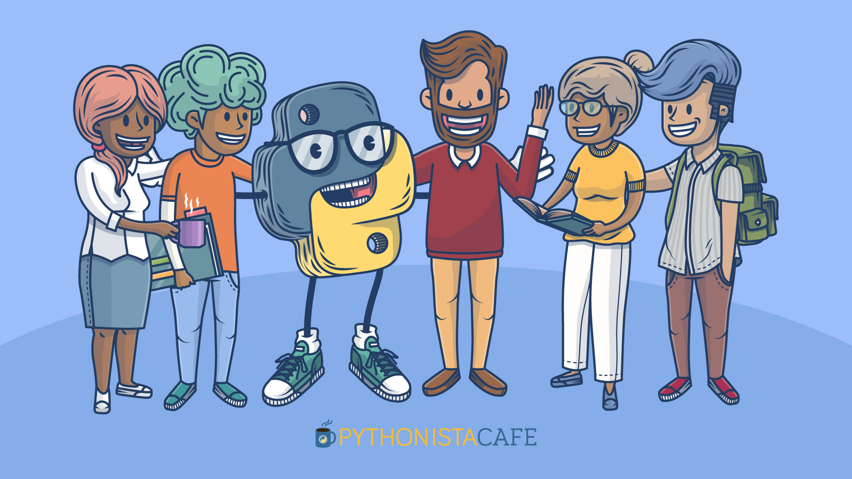
Vibrant Community and Resources

Slide 11
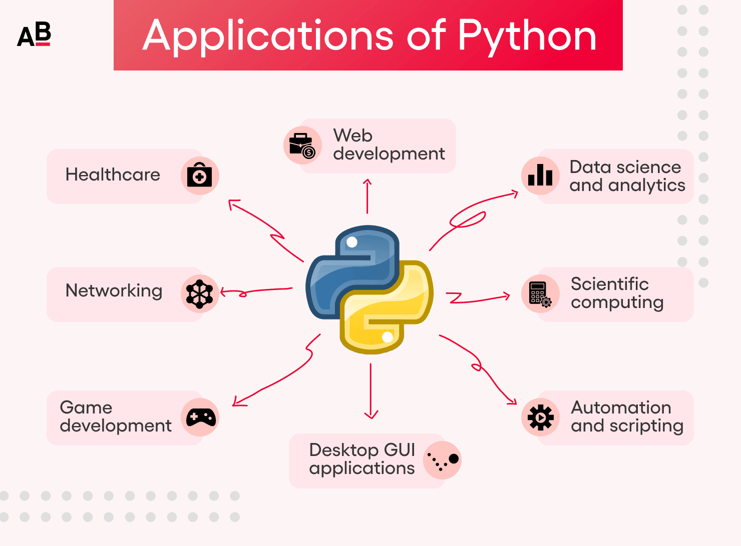
Wide Range of Applications

Slide 12
3. Getting Started with Python
3.1. Installing Python
3.2. Python IDE (PyCharm)

Slide 13
4. Python Syntax
Python syntax refers to the set of rules and conventions that dictate how Python code should be written in order for it to be interpreted correctly by the Python interpreter. It defines the structure and formatting of Python programs.
Python code is written as a sequence of statements. Each statement represents an action or a command.

Slide 14
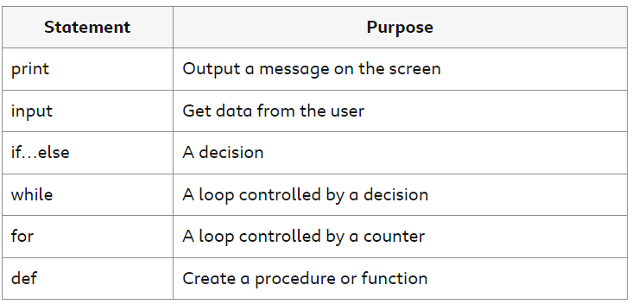
For example:

Slide 15
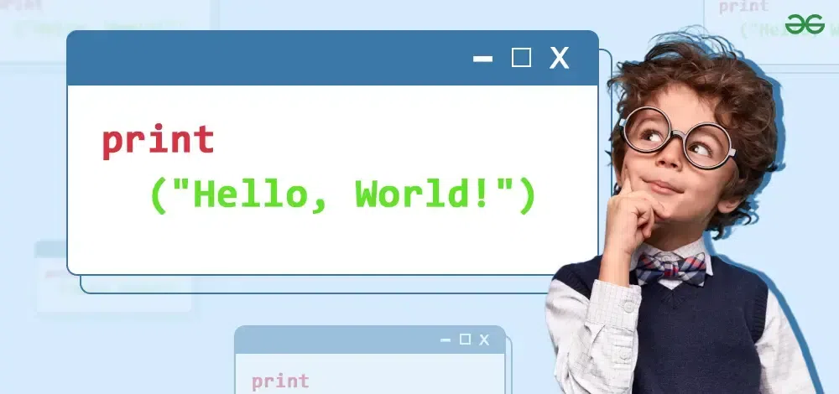
5. First Python Program – Hello, World!

Slide 16
Here’s how you can print “Hello, World!” in Python:
Hello, World!
Output
print("Hello, World!")

